Slide 1
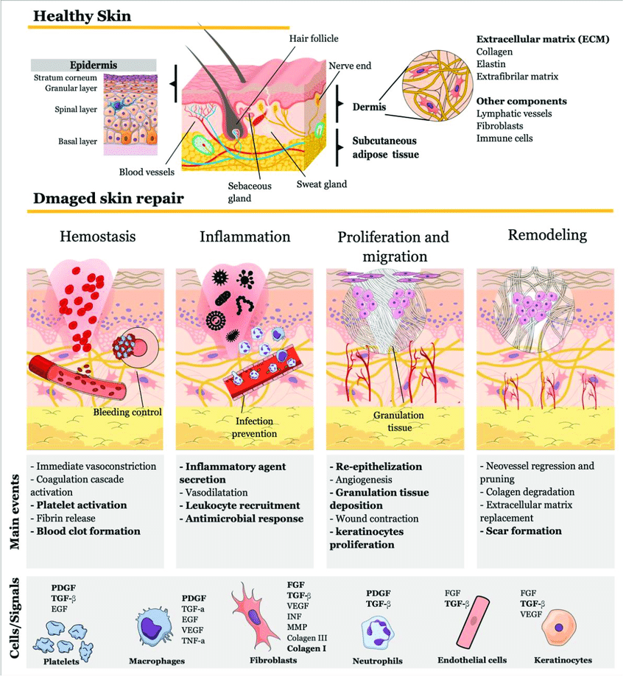
Skin
Presente by : Doaa koosh , Siraj Abo Koosh
UG Number 2401856 , 2401859

Slide 2
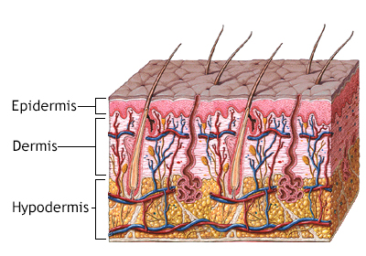
Introduction
The skin is the largest organ of the human body, covering approximately 18 square feet in adults and weighing about 8 pounds.
It serves multiple essential functions, including:Protecting internal organs from external threats.
Regulating body temperature through sweat and blood flow.
Providing sensory information about the environment.
The skin is a dynamic organ that undergoes constant renewal and repair.

Slide 3
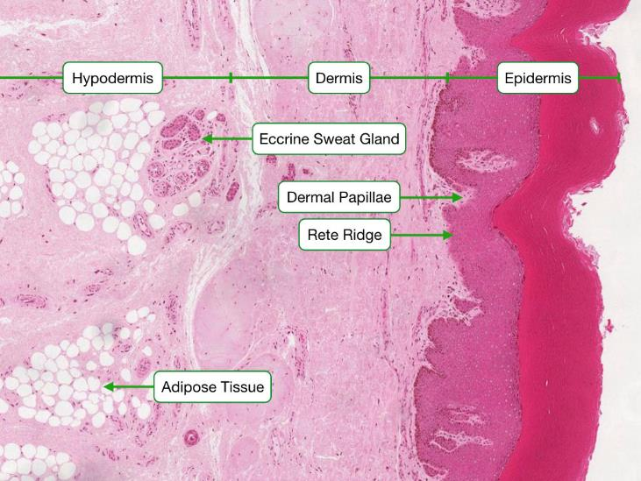
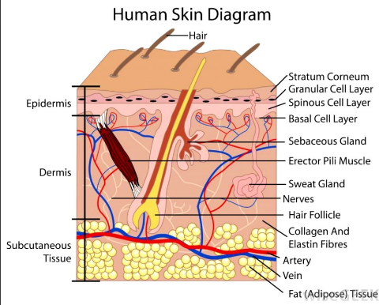
Skin layer
Layer | Description | Key Functions
Epidermis | Outermost layer made of stratified squamous epithelium. | - Acts as a protective barrier against environmental hazards (pathogens, chemicals, UV radiation).
Dermis | Middle layer with connective tissue, blood vessels, nerve endings, and hair follicles. | - Provides structural support, thermoregulation, and sensory feedback.
Subcutaneous Layer Hypodermis | Deepest layer composed of adipose and connective tissue. | - Insulates the body, stores energy, and anchors the skin to underlying muscles and bones.

Slide 4
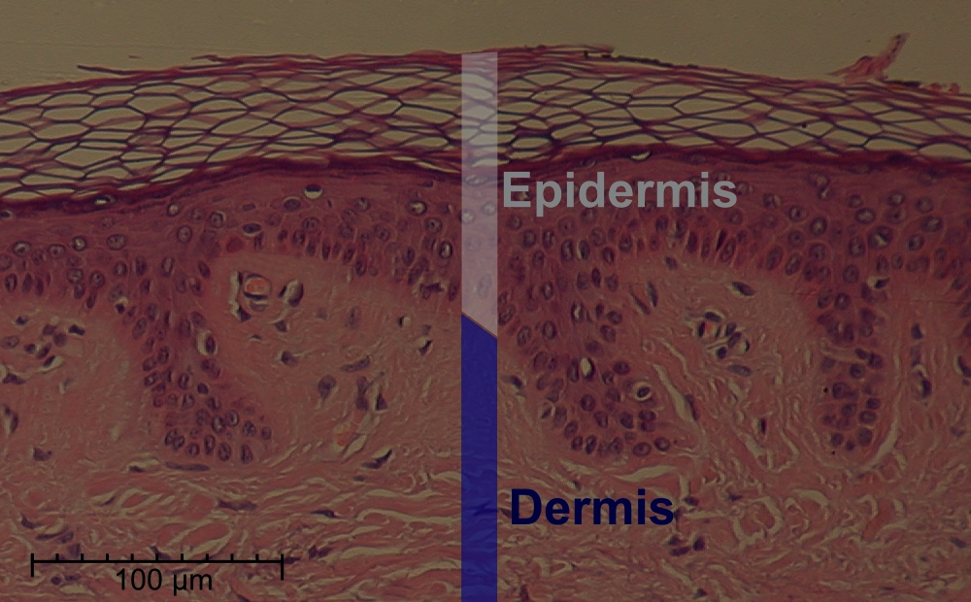
Epidermis Details
The epidermis is composed mainly of keratinocytes, which produce keratin, a protective protein.
Key components include : Melanocytes: Cells that produce melanin, responsible for skin color and protection against ultraviolet (UV) radiation. Increased melanin production leads to tanning.
Langerhans Cells: Immune cells that help protect against pathogens.
Merkel Cells: Sensory cells involved in touch perception.
The epidermis has no blood vessels; it receives nutrients from the dermis below.

Slide 5
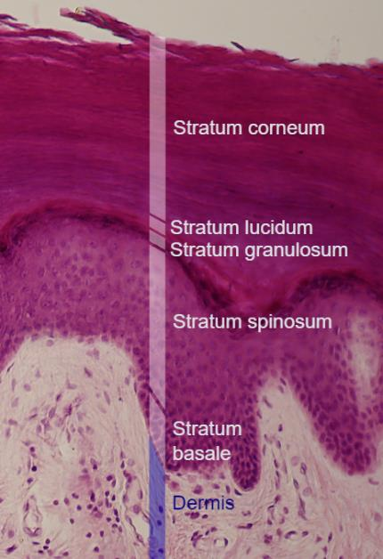
The epidermis is a keratinized layer with five strata in thick skin:
Stratum Basale: Mitotically active layer containing melanocytes and Merkel cells.
Stratum Spinosum: Contains Langerhans cells; provides strength and flexibility.
Stratum Granulosum: Forms a waterproof barrier with keratohyalin granules.
Stratum Lucidum:
Present only in thick skin, e.g., palms and soles.
Stratum Corneum: Outermost layer of dead keratinized cells.

Slide 6
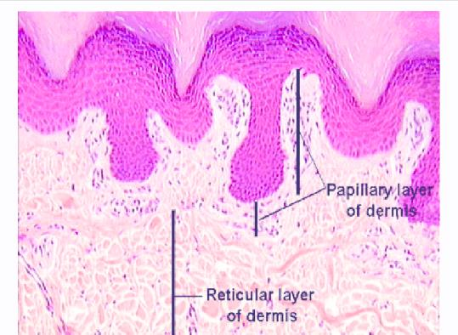
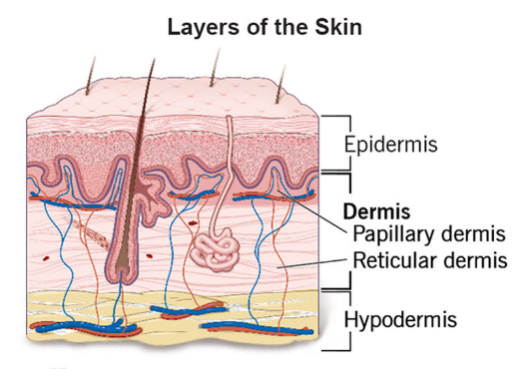
Dermis Structure
The dermis is much thicker than the epidermis and is divided into two layers:
Papillary Layer: Composed of loose connective tissue, this layer contains small blood vessels and sensory neurons. It forms dermal papillae that interdigitate with the epidermis, enhancing nutrient exchange.
Reticular Layer: Made up of dense irregular connective tissue, this layer provides strength and elasticity.
It houses:
sweat glands (eccrine and apocrine)
Sebaceous (oil) glands
Hair follicles
Blood vessels
Nerves

Slide 7
Functions of the Skin
Function | Description | Mechanism
Protection | Acts as a physical barrier against mechanical injuries, pathogens, chemical exposure, and UV radiation. | - Keratinized cells, melanin production, and lipid barriers.
Thermoregulation | Regulates body temperature by adjusting sweat production and blood flow. | - Sweating cools the body; blood vessel dilation or constriction retains or dissipates heat.
Sensation | Detects touch, pressure, pain, and temperature changes, enabling interaction with the environment. | - Sensory nerve endings and specialized receptors like Merkel cells and Meissner corpuscles.

Slide 8
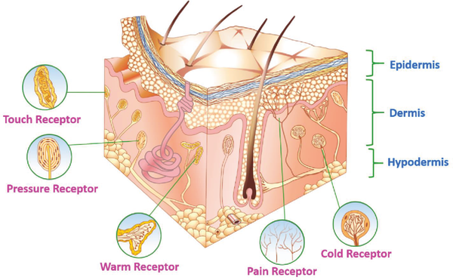
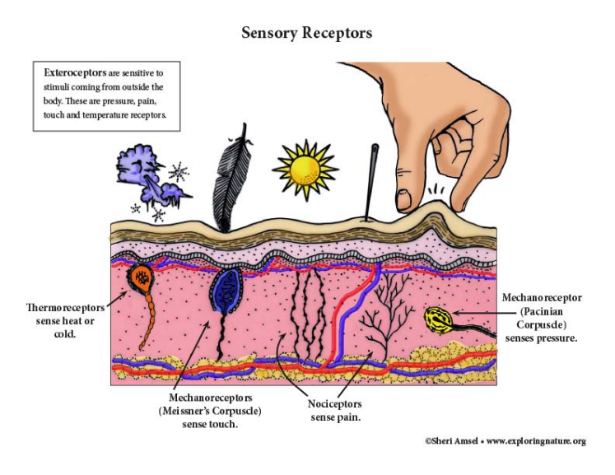
Sensory Receptors in the Skin
Free Nerve Endings: Detect pain and temperature changes.
Merkel Cells: Sense light touch and texture.
Meissner Corpuscles: Detect light touch in dermal papillae.
Pacinian Corpuscles: Respond to pressure and vibrations.

Slide 9
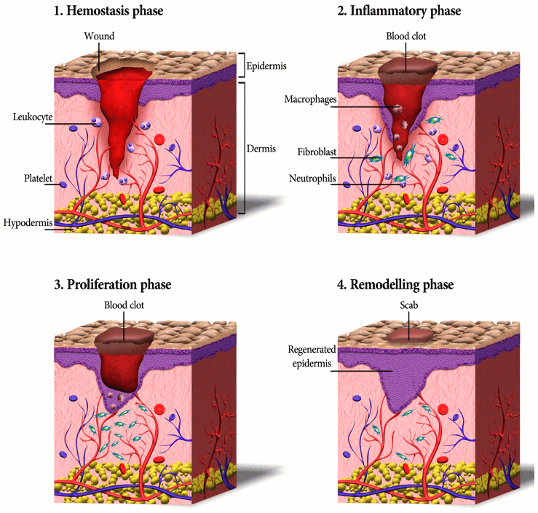
Skin Repair Mechanisms
- Hemostasis:
- Clot formation occurs at the wound site to prevent blood loss.
- inflammation:
- An immune response is initiated, involving macrophages and neutrophils that help clear debris and prevent infection.
- Proliferation:
- New tissue forms during this phase, characterized by the development of granulation tissue, which includes new blood vessels and collagen.
- Remodeling:
- Collagen fibers reorganize and mature, strengthening the healed area and restoring skin integrity.

Slide 10
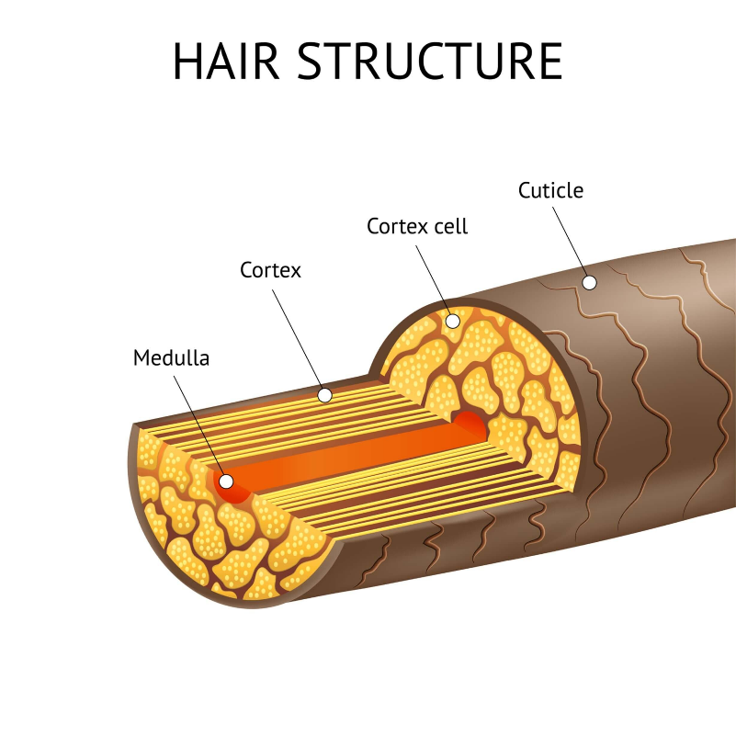
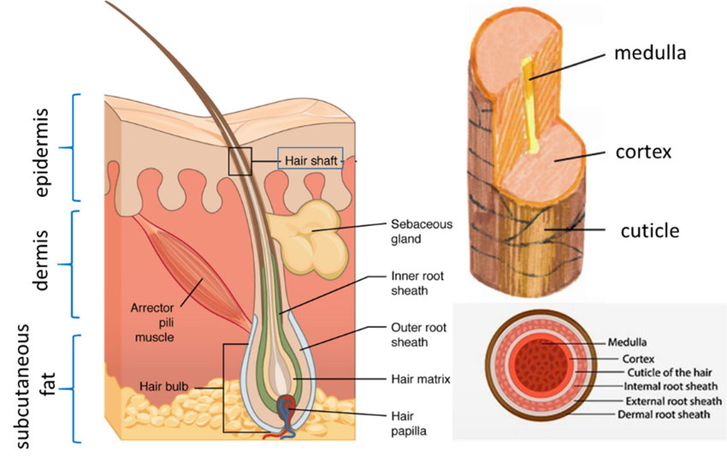
Hair
Feature | Description | Function
Structure
Shaft | Visible part; dead, keratinized cells. Layers: Medulla (inner, may be absent), Cortex (middle, color), Cuticle (outer, protective). | Medulla: May provide insulation; Cortex: Provides strength, elasticity, and color; Cuticle: Protects the cortex from damage and moisture loss.
Root | Embedded in follicle; includes hair bulb (cell production). | Anchors the hair and is the site of hair growth.
Follicle | Surrounds root, provides support and nourishment. | Supports hair growth by providing a channel and supplying nutrients.

Slide 11
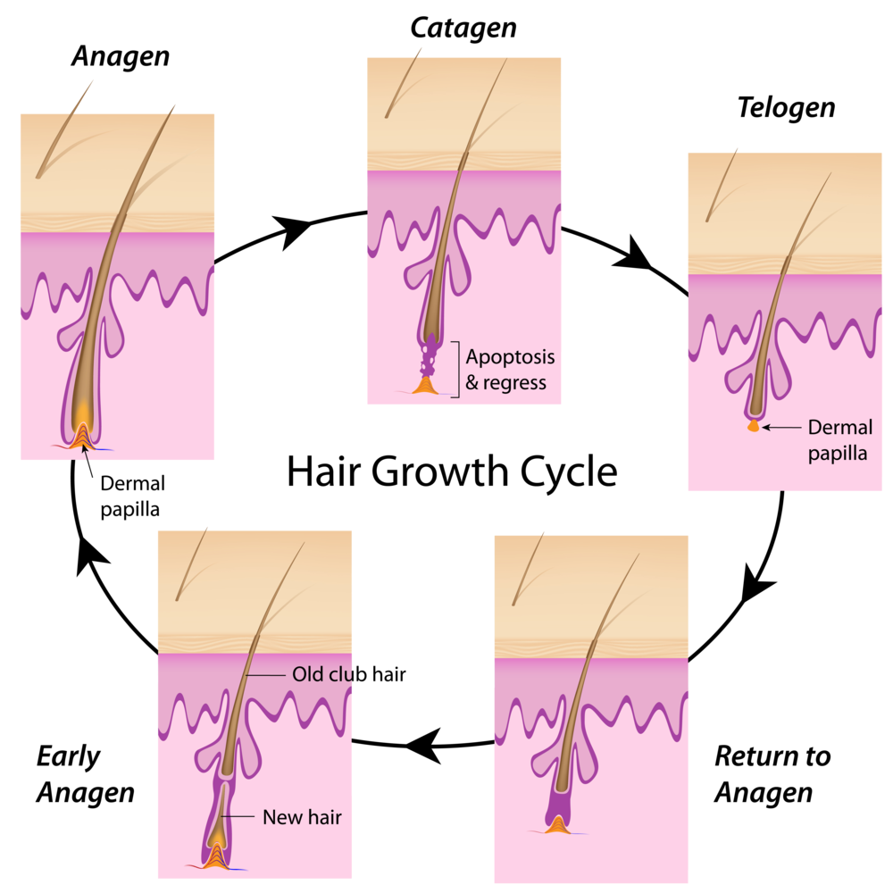
HAIR
Growth Cycle
Anagen | Active growth; rapid cell division. | Produces new hair cells, leading to hair lengthening.
Catagen | Transition phase; growth slows, follicle shrinks. | Prepares the follicle for the resting phase.
Telogen | Resting phase; hair sheds, new growth begins. | Allows for follicle regeneration and the start of a new growth cycle.
Functions
Protection | Protects scalp from UV and injury; eyelashes/eyebrows protect eyes. | Shielding against environmental hazards.
Thermoregulation | Traps warm air near the skin. | Maintaining body temperature.
Sensory | Nerve endings detect movement. | Providing information about the surrounding environment

Slide 12
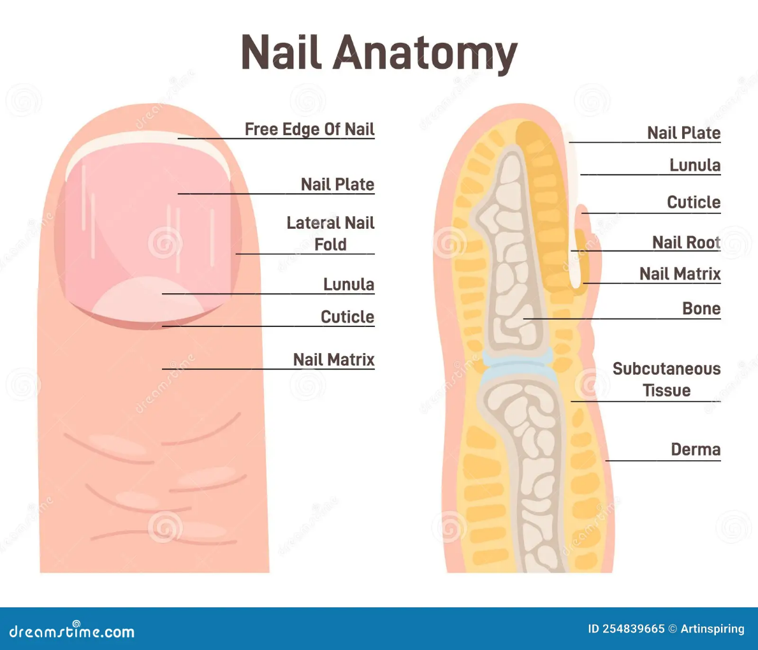
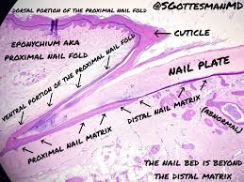
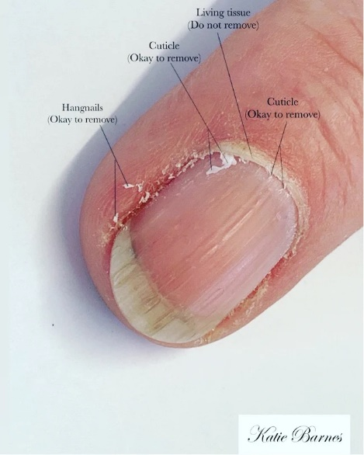
NAIL
Feature | Description | Function
Structure
Nail Plate | Hard, visible part; tightly packed keratinized cells. | Protects the fingertip/toetip.
Nail Bed | Skin under the plate; supports it, contains blood vessels and nerves. | Provides support and nourishment to the nail plate.
Nail Matrix | Under nail base (cuticle area); new cell production. | Responsible for nail growth.
Lunula | White crescent at the base; visible part of the matrix. | Visible indication of nail growth activity.
Functions
Protection | Protects fingertips and toes. | Shielding against injury and trauma.
Sensation | Improves tactile sensitivity. | Enhancing the sense of touch by providing counter-pressure.
Grasping | Assists in gripping objects and fine motor skills. | Facilitating manipulation of small objects.

Slide 13
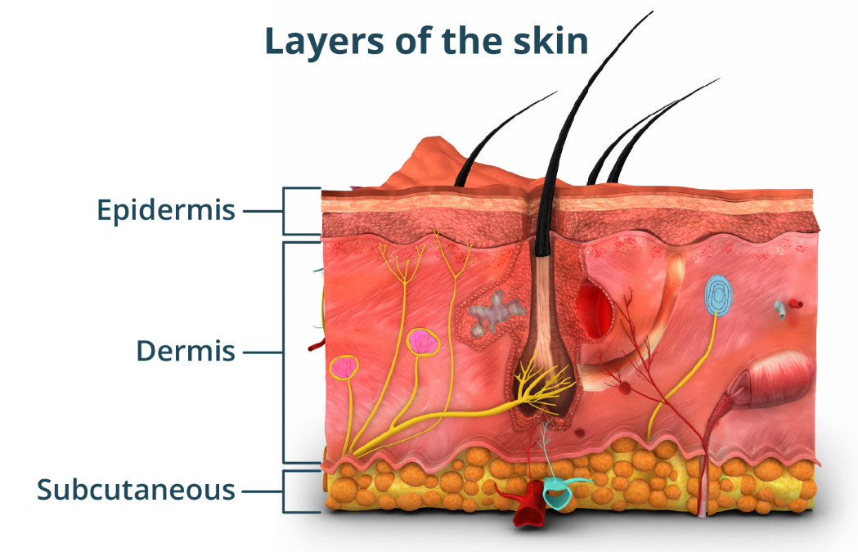
Thank you

